Slide 1
Cities and the environment mainstreaming environmental concerns into city development strategies
Learning and Leadership Group Workshop
Sharon Gil
UNEP Built Environment Unit
24 July 2012
Notes:
1
1

Slide 2
OUTLINE
Part 1: Background
UNEP’s Work on Cities and Buildings
The Global Agenda and Rio+20
Part 2: Project Overview
Mainstreaming Environmental Concerns into the City Development Strategy
Notes:
Good morning Mayor Binay, Mayor Bautista, ladies and gentlemen,
This morning, Sharon and I will very briefly present the context of this project within the global perspective. I will present the rationale behind this activity and summarize UNEP’s work on cities and buildings.
Sharon will then go into details and explain the project, Mainstreaming Environmental Concerns into the CDS

Slide 3
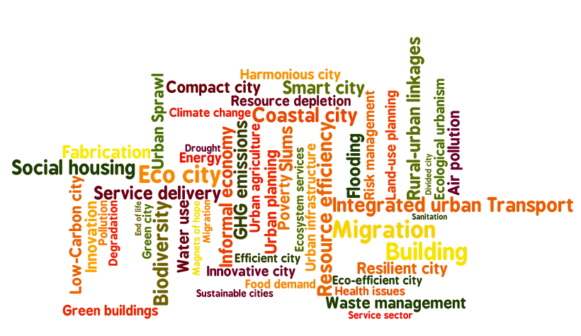
Part 1: Cities and the Environment

Slide 4
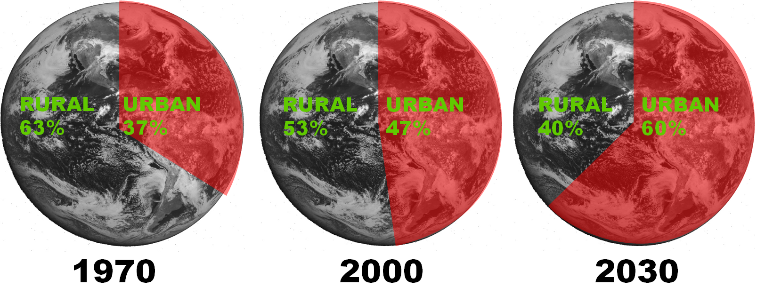
Cities and the Environment
An Urban Future
Our future is urban
Notes:
Why are cities important?
Current trends show that our future is urban.
The world’s urban population increased from about 200 million (15% of world population) in 1900 to 2.9 Billion (47% of world population) in 2000.
Globally, approximately 150,000 people become new urban citizens every day

Slide 5
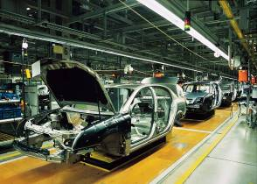
Cities and the Environment opportunities for sustainable growth
Cities produce most of the world’s economic outputs.
Centres of knowledge and innovation: Cities drive business development and job creation.
Economies of Scale: the potential to increase resource efficiency.
Notes:
But while cities are major sources of pollution, they also present opportunities for sustainable growth.
(Bullet 1)
Cities have huge concentrations of capital that can be utilized for sustainable growth. 55% of GNP in Least developed countries are in cities. In developed countries, 85% of the income is made in cities
(Bullet 2)
Cities are also knowledge hubs.
(Bullet 3)
When designed intelligently, cities can be more resource efficient. The delivery of services can be made to work for more people. The huge numbers of people allow for sustainable forms of transport, thus making it unecessary to utilize energy intensive modes of transport like cars.

Slide 6
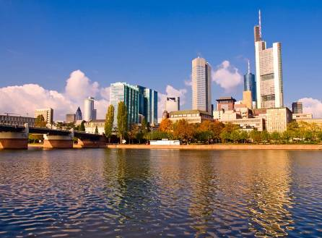
UNEP working with Cities Focusing on the Opportunities
Global environment agenda to local action
Advocate for resource efficient cities
Promote growth through a green economy
Notes:
We recognize that a lot of problems emanate from cities, the UNEP Urban Programme focuses on the opportunities urban areas present. We believe that cities can be agents for positive change.
Our work in UNEP links the global agenda to local actions by advocating for resource efficiency and promoting the green economy in the context of poverty alleviation and sustainable development

Slide 7
UNEP working with cities resource efficiency -> green economy
We work to ensure that natural resources are produced, processed and consumed in a more environmentally sustainable way, paving the way towards a Green Economy
Notes:
The photo of this ant carrying a leaf twice its size is the very nature of resource-efficiency. The logic is that we can produce the same products or the same result without having to consume more of our natural resources.
In UNEP we see resource efficiency from a life-cycle and value chain perspective. This means reducing the total environmental impact of goods and services, from raw material to final use and disposal.
Resource efficiency is also central to poverty alleviation. Wasteful use of resources – be it water, land, biomass, energy or materials – undermines the ability of societies worldwide to reduce the poverty gap. In many developing countries for example, the amount of money used on solid waste disposal surpasses the amount of money invested in primary education.
Resource efficiency is a way to move towards a green economy - one that results in improved human well-being and social equity, while significantly reducing environmental risks and ecological scarcities. In a green economy, growth in income should be driven by public and private investments – investments that reduce carbon emissions and pollution, enhance energy and resource efficiency, and prevent the loss of biodiversity and ecosystem services. In other words, a green economy is a vehicle for achieving sustainable development.

Slide 8
Cities and the Environment opportunities for sustainable growth
Investing just 2% of global GDP into ten key sectors can kick start the transition
Greening produces a higher growth in GDP and GDP per capita
Greening = job creation
Notes:
Last year, UNEP released its green economy report that produced some interesting results.
(Bullet 1)
The new UNEP report demonstrates that a transition to a green economy is possible by investing 2% of global capita per year (currently about 1.3 Trillion USD) between now and 2050 in a green transformation of key sectors, including agriculture, buildings, energy, fisheries, forests, manufacturing, tourism, transport, water and waste management. However, such investments must be spurred by national and international policy reforms.
(Bullet 2)
A green investment scenario achieves higher annual growth rates than a business as usual scenario within 5-10 years. This economic growth is characterized by a significant decoupling from environmental impacts with the global ecological footprint to biocapacity ratio.
(Bullet 3)

Slide 9
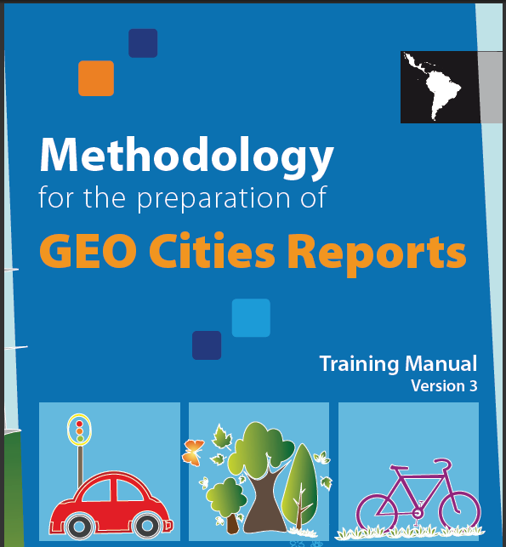
UNEP working with cities cities and climate change
Knowledge Center Cities and Climate Change (K4C) March 8, 2012 http://www.kcccc.info/preview
Urban CDM: Partnership with the City of Gwanju, South Korea
Conducting city-level environmental assessments: the GEO Cities series.
Notes:
In pursuing the goals of resource efficiency and sustainable growth, one of UNEP’s focus areas is on cities and climate change. In addition to this project on mainstreaming environment into the CDS which I will explain in greater detail later, we are also working with cities and other international actors.
(Bullet 1)
Working with the Cities Alliance, UN-Habitat, and the World Bank; UNEP is taking the lead in establishing a knowledge center on cities and climate change that will be launched this March 8 2012. The web portal contains the most information on the subject in terms of documents, city actions, and expert options. It includes a list of organizations in the field of cities and climate change.
(Bullet 2)
We also have a key partnership with Gwangju, South Korea. From 2011 UNEP collaborated with Gwangju to develop a project on sustainable cities. This includes the assessment of the environmental performance of the city (including GHG monitoring and reporting) and the possibility of applying urban CDM methodology.
(Bullet 3)
UNEP also has a the global GEO Cities. To guide cities in conducting Integrated Environmental Assessments in cities.
The GEO Cities helps cities analyse the state of the local environment and the impacts of cities on the local, national and global environment. UNEP has been supporting GEO Cities in Latin American, the African region and Eastern Europe.

Slide 10
UNEP working with cities greening buildings with private sector
Sustainable Building and Climate Initiative(SBCI)
Over 18 private sector partners
SBCI provides a common voice for the building sector
Establishes standards and benchmarking systems like the Common Carbon Metric system to assess the environmental performance of buildings
Notes:
We of course recognize that how we build cities is central to combating climate change and that the private sector plays a huge role in this sector.
(Bullet 1)
One of our major programs in this area is the Sustainable Building and Climate Initiative which promotes partnership of major public and private sector stakeholders in the building sector, working to promote sustainable building policies and practices worldwide. Partners include material industries, architecture firms, building technologies and air-conditioning companies, local authorities such as in Montreal, Sao Paolo, Madrid. We have over 18 private sector partners including big companies all over the world.
(Bullet 2)
Drawing on UNEP’s unique capacity to provide a global platform for collective action, the SBCI brings together the building sector stakeholders. It provides common voice for them on sustainable buildings and climate change.
(Bullet 3)
The Common Carbon Metric is a tool developed by SBCI. It is the calculation used to define measurement, reporting, and verification for GHG emissions associated with the operation of buildings types. It is consistent with methods for assessing the environmental performance of buildings used globally

Slide 11
Global Initiative for Resource Efficient Cities
Launched last 18 June in Rio de Janeiro during Rio+20
Objective: To enhance the quality of life in urban areas, in particular in rapidly growing cities in developing countries, while minimizing resource extraction, energy consumption and waste generation, and while safeguarding ecosystem services
What does it do?
Develop a resource footprint of cities
Links partners and cities interested in resource
efficiency
Coordinate and support the development of clear
goals and targets
Provides access to expertise

Slide 12
Part 2: Project Overview An approach for better integrating environment in urban planning
Notes:
SS: Now, I hand you over to Sharon for the second part of this presentation.
SG: Thank you Soraya. Good morning ladies and gentlemen.

Slide 13
Project Overview UNEP-Cities Alliance Partnership
2003 UNEP became full member of the Cities Alliance (CA)
UNEP’s primary interests are in:
Partnerships, coordinated actions with others
“Greening” city-oriented policies or initiatives
2005 UNEP and CA launched the “Environment Initiative”
2007 and CA commissioned a global study “Liveable Cities”
2009 UNEP and CA signed a Joint Work Programme to mainstream the environment in Cities Alliance activities
Notes:
13
13
UNEP is also building strategic partnerships such as the one we have with Cities Alliance. The timeline above details the length of our partnership from 2003-present (Note: talk on the slides above)

Slide 14
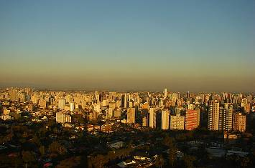
Project Overview The City Development Strategy
City Planning PLUS
People-oriented, participatory
Long term
Urban planning in action
Strategic
Notes:
14
14
CDS is city planning PLUS
A CDS first of all needs to consider the residents it is planning for. It encourages participation.
A CDS also helps cities integrate a long-term perspective into their urban planning. With a CDS, cities move beyond planning around the short-term political or donor-funding cycle to considering where they should be in 20 or 30 years, and the steps that need to be taken to achieve those goals.
It is as an action-oriented process, developed and sustained through participation, to promote equitable growth in cities and their surrounding regions to improve the quality of life for all citizens. There are definite steps towards implementation
Finally the CDS is strategic in nature. It is that well-positioned, well-timed public, private and civil society strategic interventions can significantly change a city’s development path and improve its performance. It promotes effective resource allocation, attract capital and discipline its use.

Slide 15
Project Overview
Developing a Global Approach
Future strategies will
Ensure sustainable use of natural resources: capital to grow rather than deplete
Integrate the environment in each phase of the development of the CDS
Notes:
15
What we are doing here today with the IIED is going beyond that and establishing a global approach that can enrich the CDS even further. This room are pioneers at developing a global approach to ensure that future strategies will ensure that natural resources are used sustainably and that these concerns are integrated in each phase of the development of the CDS.

Slide 16
Project Overview Developing a Global Approach
Mobilizing partners and technical expertise
Stock taking exercise
Learning and Leadership Group
Development of the methodology
Pilot testing
Refinement of the methodology
Link with other processes and initiatives
Notes:
We are in the middle of a long process that was begun in 2011. It started with mobilizing partners and technical expertise (with IIED)
We also had a stock-taking exercise looking at our previous work on environmental mainstreaming in cities;
Now we have our Learning and Leadership Group workshops to see how cities all over the world have mainstreamed environmental planning into their city development strategies. Makati and Quezon City are the first, then we will be moving on to Jinja in Uganda and Nampula in Mozambique.
Succeeding steps will include (mention last three steps)

Slide 17
Project Overview Developing a Global Approach
The results of this process will be published –the experiences of Kampala, Jinja and other towns and cities present will be included
Notes:
In the next two days, we hope to have a fruitful discussion on environmental mainstreaming with both Makati and Quezon City.
The experiences of Makati and Quezon City will then be included in a document that details the approach for mainstreaming environmental sustainability into city planning.
The published product is envisioned to be the next “Liveable Cities” report.
Back to you Soraya

Slide 18
Thank you for your attention!
UNEP
Division for Technology, Industry and Economics
Built Environment Unit
Sustainable Consumption and Production Branch
soraya.smaoun@unep.org
sharon.gil@unep.org
Notes:
18
18

